Slide 1
Hotel management System
Design by:
Hotel Management System Team(Group-5)

Slide 2
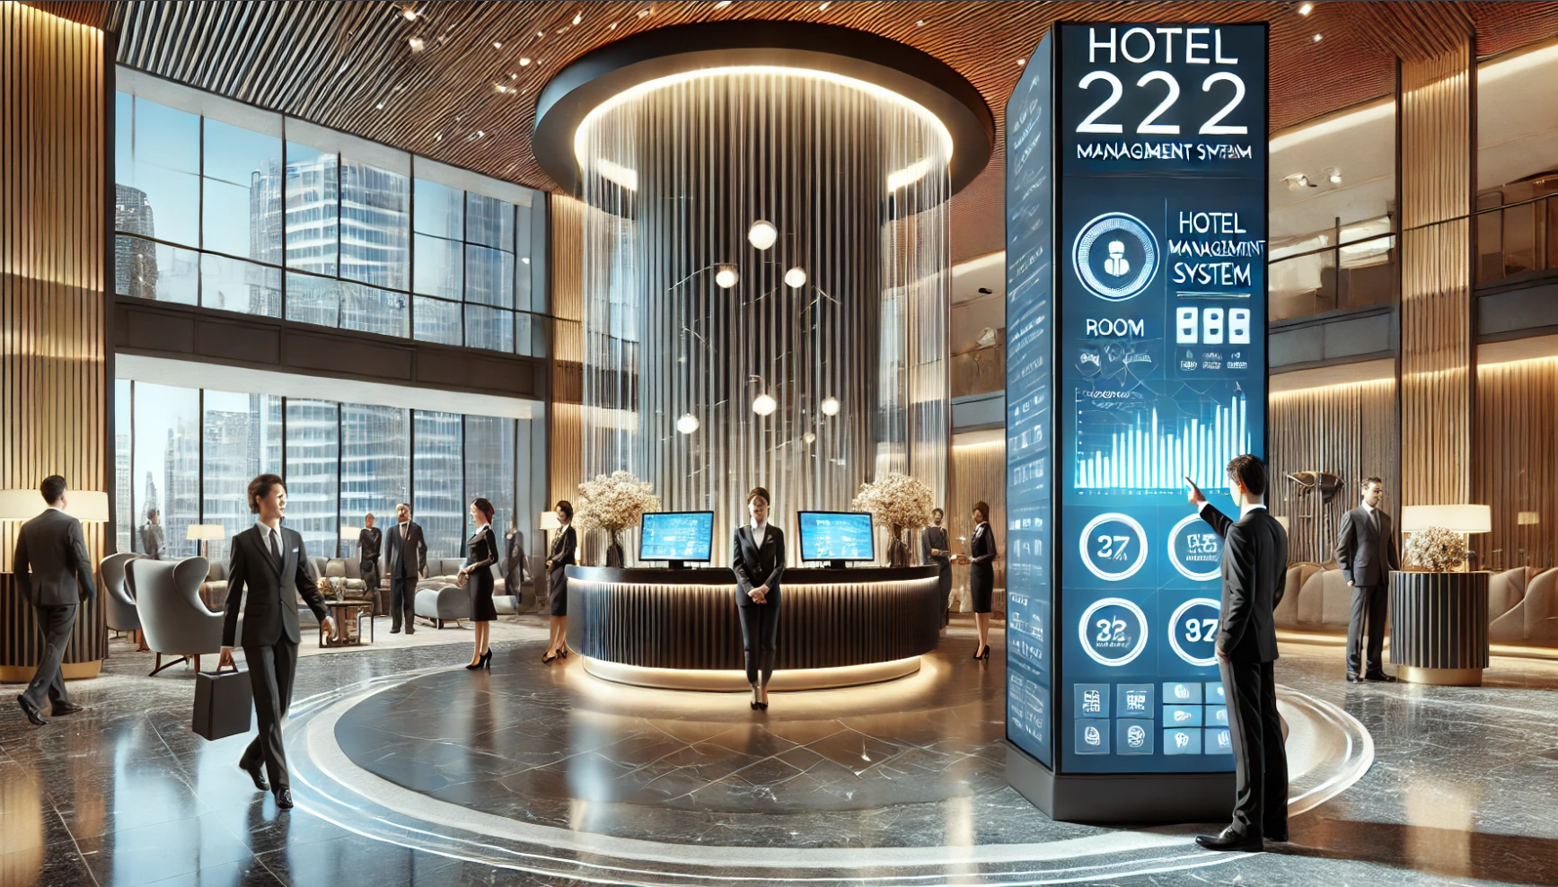





Login page
HOTEL MANAGEMENT
SYSTEM
Please Login to your account
Username
Password
Forget Password?
Login
Do you have account?
Signup

Slide 3
Login page
HOTEL MANAGEMENT
SYSTEM
Please create your account
Username
Password
✉️
Email
OTP
Send OTP
Forget Password?
Signup
Do you have account?
Login

Slide 4










Dashboard
25Oct2026,Thursday
Admin
HOTEL
MANAGEMENT SYSTEM
Today’s
Check in
Today’s
Check out
Today’s
Incomes
Total room
Available
110
20
12
10
4500000
All rooms
Rooms
New Check in
New Check out
Danga
Dashboard
Staff management
monthly
Room management
Service
Guest management
Booking
Settings
Logout

Slide 5



Staff Management
25Oct2026,Thursday
Admin
HOTEL
MANAGEMENT SYSTEM
Employees Management
Add
Search Employees…..
Employee Id | Employee Name | Start Date | Role | Salary | Experiance | Status | Actions
Em-0001 | Aung H Kyaw | 25-10-2025 | Admin | 30000 | 3 years | Active
Em-0002 | Khine S Lin | 25-10-2025 | Receptionist | 25000 | 3 years | Leave
Em-0003 | Myo H Aung | 25-10-2025 | HouseKeeping | 25000 | 3 years | Active
Em-0004 | Zaw N Oo | 25-10-2025 | Kitchen | 25000 | 3 years | Active
Em-0005 | Aung T Thar | 25-10-2025 | Finance | 25000 | 3 years | Active
Em-0006 | Kyaw K Naing | 25-10-2025 | Room Services | 25000 | 3 years | Active
Em-0007 | Phyoe E Htun | 25-10-2025 | Kitchen | 25000 | 3 years | Active
Em-0008 | Ma Ma Win | 25-10-2025 | Security | 25000 | 3 years | Termin
Em-0009 | Mra Sandar | 25-10-2025 | Driver | 25000 | 3 years | Active
Dashboard
Staff management
Room management
Service
Guest management
Booking
Settings
Logout

Slide 6
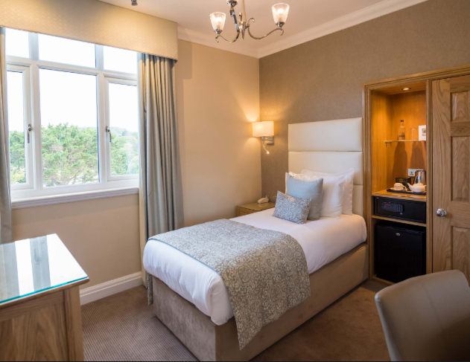
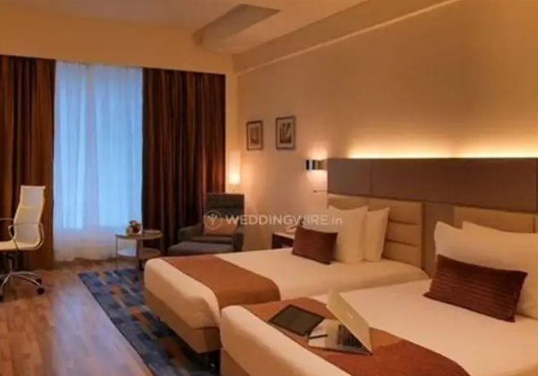
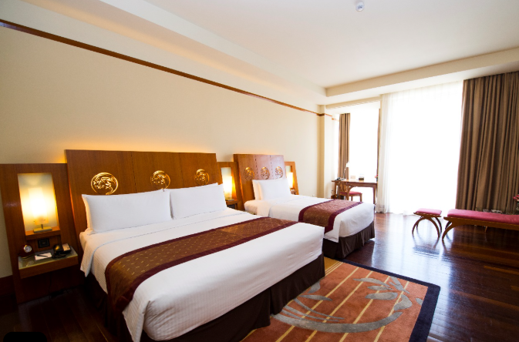
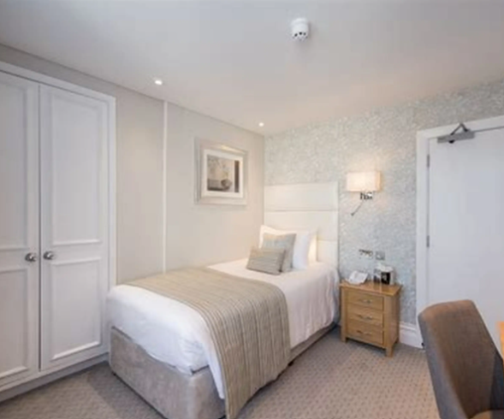
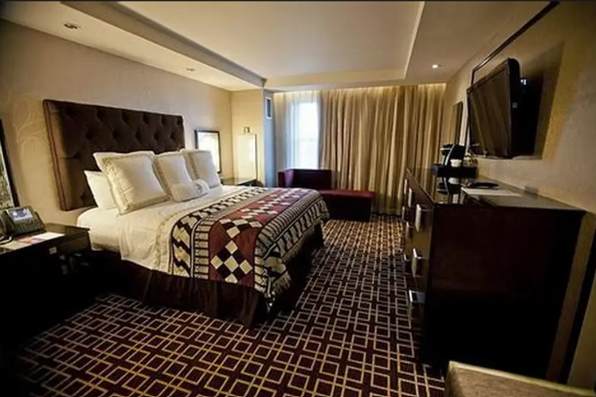
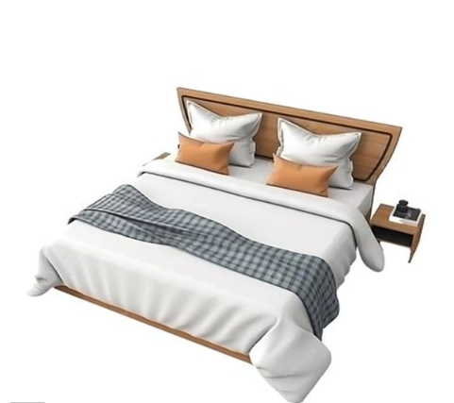
Room Management
25Oct2026,Thursday
Admin
HOTEL
MANAGEMENT SYSTEM
Rooms Management
Add
Search Rooms…..
All Rooms
Available
Occupied
Reserved
Maintenance
Dirty
Dashboard
1001
1001
1001
Staff management
Single room
Double room
Family room
Room management
Available
Occupied
Dirty
Service
15000Danga
/Night
20000Danga
/Night
25000Danga
/Night
Guest management
Booking
1001
1001
1001
Single room
Double room
Family room
Settings
Reserved
Available
Maintenance
15000Danga
/Night
20000Danga
/Night
25000Danga
/Night
Logout

Slide 7
Services
25Oct2026,Thursday
Admin
HOTEL
MANAGEMENT SYSTEM
Services
Add
Search Rooms…..
Kitchen Services
Car Services
Laundry Services
Extra Services
Dashboard
Kitchen Service
-Food & Beverage menu,
-order status
-prices
Car Service
-Car list
-booking status
-prices
Staff management
Room management
Service
Guest management
Booking
Laundry Service
-wash & dry & iron clothes
- prices
Extra Service
-spa,minibar,Extra Bed,Hall
-order status
- prices
Settings
Logout

Slide 8
Guest Management
25Oct2026,Thursday
Admin
HOTEL
MANAGEMENT SYSTEM
Guest Management
Show All
Search Guests…..
Guest Id | Guest Name | Date Order | Room Types | Check In | Check Out | Status | Action
Gu-0001 | Hein Kyaw | 25-12-2026 | Single | 28-12-2026 | 30-12-2026 | Active
Gu-0002 | Soe Lin | 25-12-2026 | Double | 28-12-2026 | 30-12-2026 | Active
Gu-0003 | Hsan Aung | 25-12-2026 | Family | 28-12-2026 | 30-12-2026 | Active
Gu-0004 | Naing Oo | 25-12-2026 | VIP | 28-12-2026 | 30-12-2026 | Active
Gu-0005 | Toe Aung | 25-12-2026 | Single | 28-12-2026 | 30-12-2026 | Active
Gu-0006 | Eaindra | 25-12-2026 | Double | 28-12-2026 | 30-12-2026 | Checkout
Gu-0007 | Ma Ma Win | 25-12-2026 | Family | 28-12-2026 | 30-12-2026 | Active
Gu-0008 | Mya Sandar | 25-12-2026 | VIP | 28-12-2026 | 30-12-2026 | Active
Dashboard
Staff management
Thursday,9:00am
Room management
Thursday,9:00am
Service
Thursday,9:00am
Guest management
Thursday,9:00am
Booking
Thursday,9:00am
Settings
Thursday,9:00am
Thursday,9:00am
Thursday,9:00am
Choose Date:
25Oct2026,Thursday
Logout

Slide 9
Booking
25Oct2026,Thursday
Admin
HOTEL
MANAGEMENT SYSTEM
Booking
Add Booking
Search Rooms,Gues…..
BookingId | Room Id | Guest Name | Order Date | Check in Date | Check out Date | Deposit | Status | Action
Bk-0001 | 1001 | Aung K | 13-2-2026 | 13-2-2026 | 13-2-2026 | 1000Danga | Confirm
Bk-0002 | 1002 | Khine S | 13-2-2026 | 13-2-2026 | 13-2-2026 | 1000Danga | Pending
Bk-0003 | 1002 | Myo H | 13-2-2026 | 13-2-2026 | 13-2-2026 | 1000Danga | Cancel
Bk-0004 | 1002 | Zaw N | 13-2-2026 | 13-2-2026 | 13-2-2026 | 1000Danga | Confirm
Bk-0005 | 1002 | Aung T | 13-2-2026 | 13-2-2026 | 13-2-2026 | 1000Danga | Pending
Dashboard
Staff management
Thursday,9:00am
Room management
Thursday,9:00am
Service
Thursday,9:00am
Guest management
Booking
Thursday,9:00am
Settings
Thursday,9:00am
Choose Date:
25Oct2026,Thursday
Logout

Slide 10
Settings
25Oct2026,Thursday
Admin
HOTEL
MANAGEMENT SYSTEM
Settings
About
General
Rate & Tax
Payment
Dashboard
Zeyon Hotel
Staff management
Room management
📍 Address: No. 365, Temple Road,
📞 Phone: +95 9 123 456 789
✉️ Email: info@zeyonhotel.com
🌐 Website: www.zeyonhotel.com
Service
Guest management
Booking
💻 SYSTEM INFORMATION
Settings
• Software Name: Hotel Management System
• Version: v1.0.4 (Updated 2026)
• Developer: [ Group-V Company ]
• Technical Support:support@groupfive.com
• +95 9 987 654 321
Zeyon Hotel
Logout

Slide 11
Settings
25Oct2026,Thursday
Admin
HOTEL
MANAGEMENT SYSTEM
Settings
About
About
Rate & Tax
General
Payment
Dashboard
Rate&Tax
-season & promotion
-Booking policy
-Extra Services Rate
-Checkin & Checkout time
Staff management
General
-admin account informatin
-date time
-language
Room management
Service
Guest management
Booking
Payment
-Payment Method
-Deposit Setting
-tax & services charges
Settings
Zeyon Hotel
Logout

Slide 12
Receptionist
25Oct2026,Thursday
Receptionist
HOTEL
MANAGEMENT SYSTEM
Receptionist
Add
Search Rooms…..
All Rooms
Available
Occupied
Reserved
Maintenance
Dirty
Receptionist
1001
1001
1001
Room management
Single room
Double room
Family room
Service
Available
Occupied
Dirty
Guest management
25000Danga
/Night
15000Danga
/Night
20000Danga
/Night
Booking
Check In
1001
1001
1001
Check Out
Single room
Family room
Double room
Settings
Reserved
Available
Maintenance
15000Danga
/Night
20000Danga
/Night
25000Danga
/Night
Logout

Slide 13
Room Management
25Oct2026,Thursday
Receptionist
HOTEL
MANAGEMENT SYSTEM
Rooms Management
Single
Search Rooms…..
All Rooms
Available
Occupied
Reserved
Maintenance
Dirty
Receptionist
Room management
1001
1001
1001
Single room
Double room
Family room
Service
Available
Occupied
Dirty
Guest management
15000Danga
/Night
20000Danga
/Night
25000Danga
/Night
Booking
Check In
1001
1001
1001
Check Out
Single room
Double room
Family room
Payments
Reserved
Available
Maintenance
Reports
15000Danga
/Night
20000Danga
/Night
25000Danga
/Night
Settings
Logout

Slide 14
Hotel management system
Question & Discussion
Result by:
-Hotel Management System Team

